Slide 1
Sports Apparel Industry
Presented by: Blaine Killen, Eric Morris and Mary Russo

Slide 2
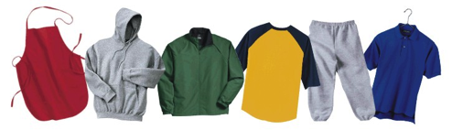
What is Sports Apparel?
Definition

Slide 3
Industry Introduction
Worth a total of $41.467 Billion US dollars
International Sales

Slide 4
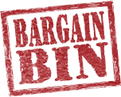
Bargaining Power of Buyers
Moderately high; varies in different demographic regions.
Quality can lead to higher prices

Slide 5
Bargaining Power of Suppliers
Moderately low due monotony of product line
If they aren’t happy they can always look somewhere else for a lower price

Slide 6
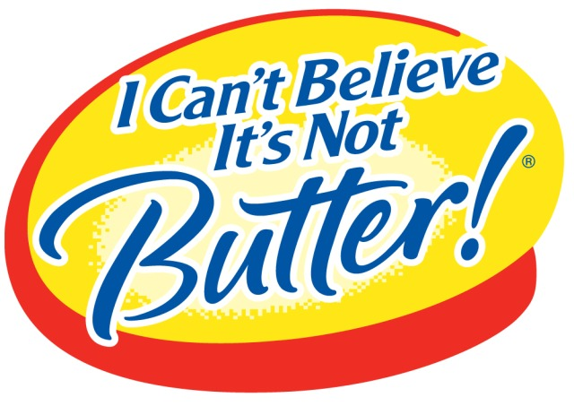
Substitutes
Many substitutes for sneakers but not many that people can work out in.
Example: I wouldn’t work out in a pair of boots.
The same goes for clothing and equipment.

Slide 7
Potential Entrants
Brand loyalty would be the most difficult barrier to overcome.
Example: Nike’s selling price compared to off brand.
Capital is another barrier that not all beginners may be able to break through.

Slide 8
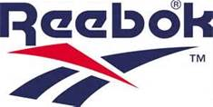
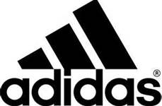
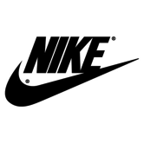
Within Industry Rivalries
6% Market Share
5% Market Share
6% Market Share

Slide 9
Reebok
Producer of athletic shoes, apparel and accessories
Huge global presence
CrossFit Line

Slide 10
Adidas
Design and manufacture sports clothing and accessories
Large presence in in soccer and tennis
Medium for athlete branded clothing

Slide 11
Nike
Engaged in design, development, and worldwide marketing and selling of footwear, apparel, equipment, accessories, and services
CEO- Phillip Knight
Pro-Combat and Element lines

Slide 12
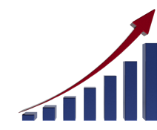
Future Growth
Predicted growth of 6% worldwide for next five years
2017: $125 billion market cap
The giants will become increasingly segmented

Slide 13
Sports Apparel Industry

